Slide 1
Shedding light on Dark patterns
Navigating Deceptive Design in the Digital World

Slide 2
TABLE OF CONTENTS
1.
5.
2.
6.
3.
7.
Introduction
Effects on Users
Types of Dark Patterns
Legal Considerations
Case Studies
Conclusion
4.
8.
Combatting Dark Patterns
Our team

Slide 3
1
ABOUT THE PROJECT

Slide 4

ABOUT THE PRODUCT
Web Extension: Enhancing E-commerce Experience
Identify deceptive elements using web scraping and ML
Screenshots highlighting flagged elements on e-commerce websites

Slide 5

FUTURE ADVANCEMENTS
Advanced Dark Pattern Detection
Enhanced AI-Powered Chatbot
Multi-Platform Support
Data Privacy and Ethics
User Empowerment Tools

Slide 6
2
Types of dark patterns

Slide 7
BASIC TYPES OF DARK PATTERNS IN E-COMMERCE WEBSITES
Hidden Costs
surprising users with unexpected fees.
Misleading Discounts
Sneak into Basket
misleading users about the actual value of the deal
Adding items to the user's cart without their consent
Bait and Switch
Urgency Tactics
Promoting one product or deal, then often redirecting users to anpricier option.
Creating pressure to buy by implying scarcity

Slide 8
IDENTIFYING DARK PATTERNS
Evaluate Choices
Ensure options are clear and unbaished
Observe user journey
Look for points of friction or deception
Test for transparency
Verify costs, commitments, and opt-out options.

Slide 9
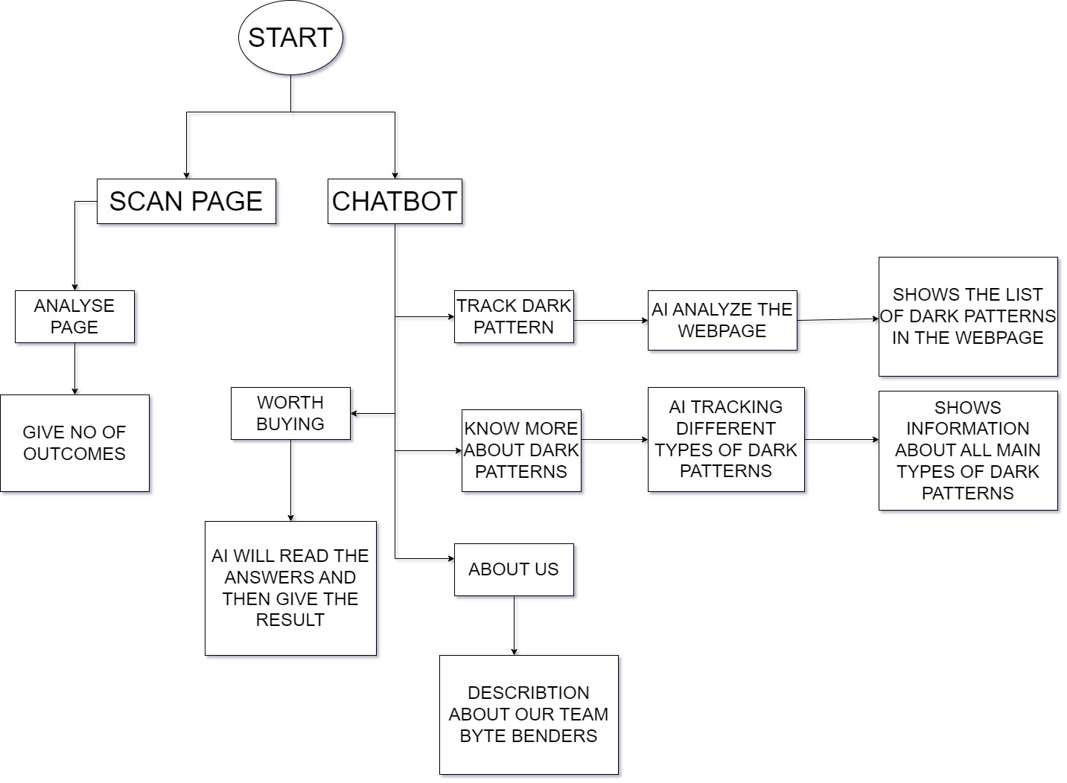
FLOW CHART

Slide 10
3
Case studies

Slide 11
Conversion Rate Boost with Dark Patterns
Description
Methodology
dark patterns such as false scarcity
comparing the website's performance with and without dark patterns.
Results
Insights
Conversion rates increased by 15% during the period
the long-term impact on customer trust and brand reputation

Slide 12
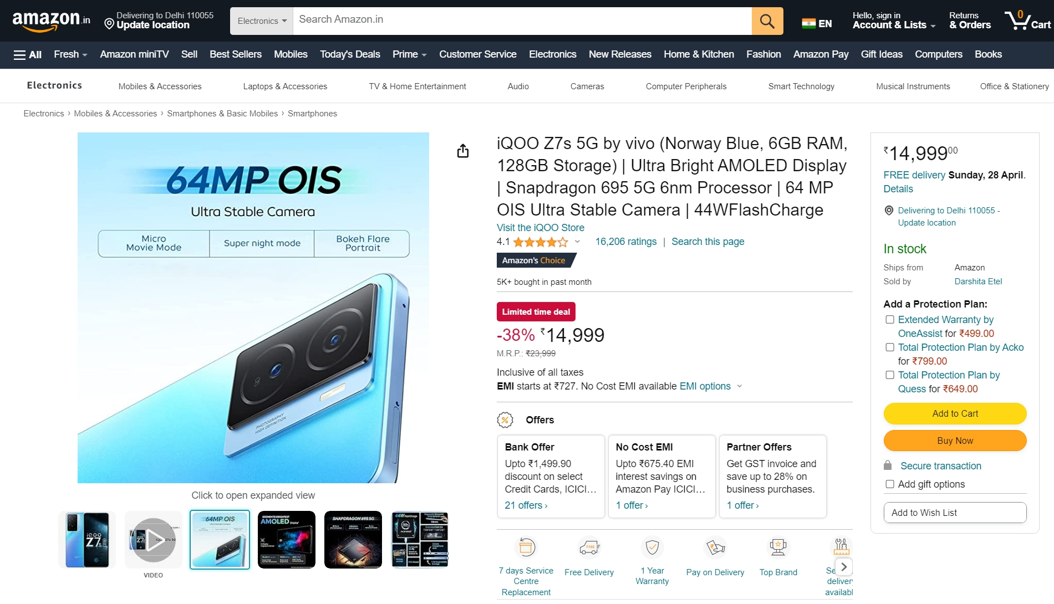
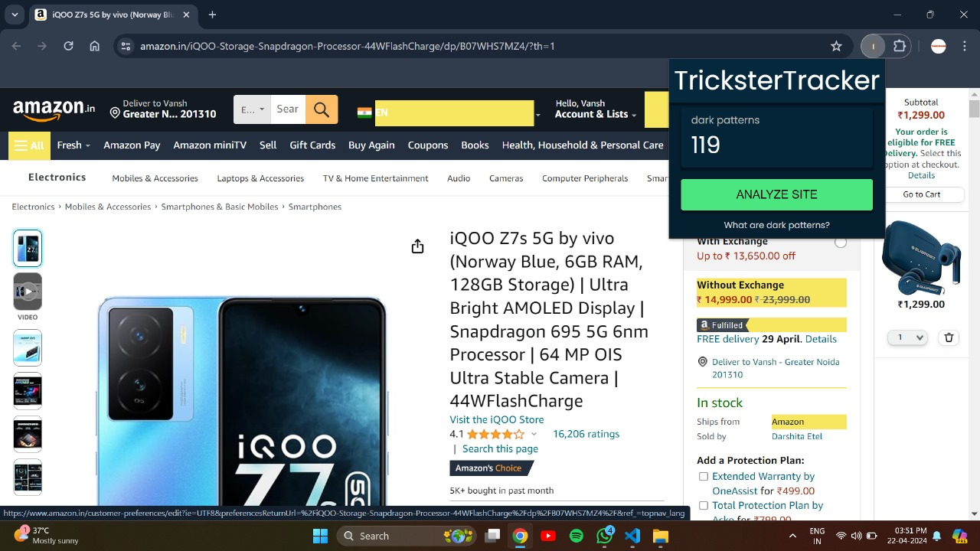
Detecting Dark patterns on a webpage shown below:

Slide 13
4
Combatting Dark Patterns

Slide 14
5% to 30%
Approximate impact of dark patterns on prices in one day

Slide 15
5
Effects of Dark Patterns on Users

Slide 16
CONSEQUENCE
Increased User Frustration
Loss of Trust
Negative Perception
Reduced User Satisfaction
Risk of Abandonment

Slide 17
6
OUR TEAM

Slide 18
ADITYA BHARDWAJ
VANSH
NISHANT
SATYAM VARSHNEY
ROBIN KUMAR

Slide 19
THANKS!
DO YOU HAVE ANY QUESTION?
Please keep this slide for attribution.

